Slide 2
Run_RTM_1D_PDE.m
↓
Config_Baseline.m / Params_Static.m
↓
Build_Grid_1D.m
↓
Build_Forcing_PDE.m
↓
Initialize_PDE_State.m
↓
Pack_State.m / Unpack_State.m
↓
RTM_PDE_RHS.m
↓
RTM_Reaction_Rates.m
↓
RTM_Carbonate.m / RTM_Bubbling.m
↓
Plot_PDE_Result.m

Slide 3
Run_RTM_1D_PDE.m
Config / Params
↓
Grid
↓
Forcing
↓
Initial State
↓
Pack into Y0
↓
ode15s solves dY/dt = RTM_PDE_RHS
↓
Unpack final state
↓
Reaction diagnostics / summary / plot

Slide 4
Config_Baseline.m and Params_Static.m
baseline simulation setup
site setup and forcing
audited kinetic and stoichiometric parameters.
Some parameters are currently treated as static, but for validation and uncertainty analysis they may later become calibrated or sampled parameters.

Slide 5
RTM_PDE_RHS.m
Y
↓
Unpack_State
↓
floor negative values for reaction calculation
↓
RTM_Reaction_Rates
↓
solid_rhs for solid species
solute_rhs for solute species
↓
Pack_State(dState)

Slide 6
RTM_Reaction_Rates.m
RTM_Reaction_Rates only computes local reaction source and sink terms.
Carbonate speciation first
OM degradation
labile OM pool drives most redox reactions.
refractory pool mainly used to represent preserved OM inventory, unless turn on a small refractory degradation rate
Redox cascade：O2 → Fe → SO4 → CH4
Sulfate reduction and AOM are restricted by SO4
CH4：methanogenesis + AOM + aerobic oxidation + bubbling
Fe/S secondary reactions :
Fe2+ oxidation；
FeS formation；
H2S oxidation；
HS free fraction controlled by pH；
O2 secondary sink
Carbonate precipitation/dissolution (Dissolved Ca2+).

Slide 7
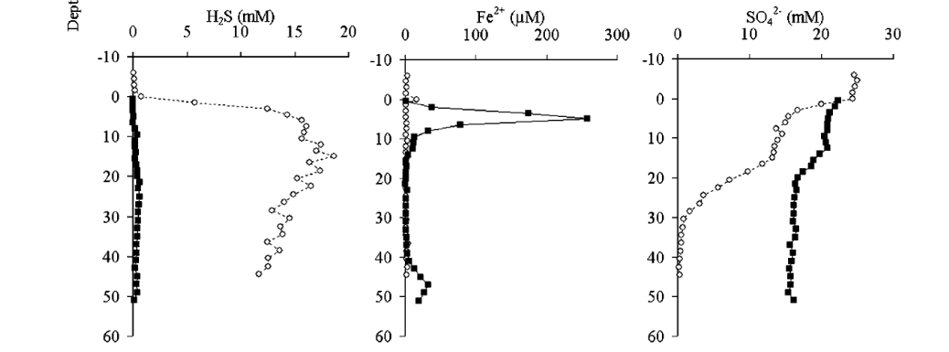
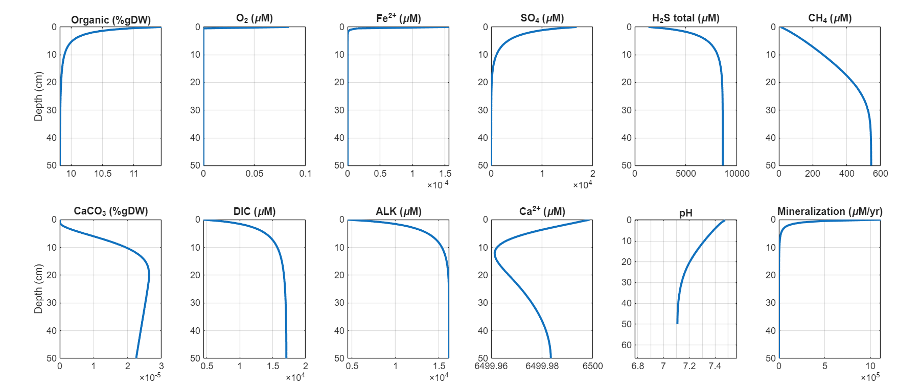
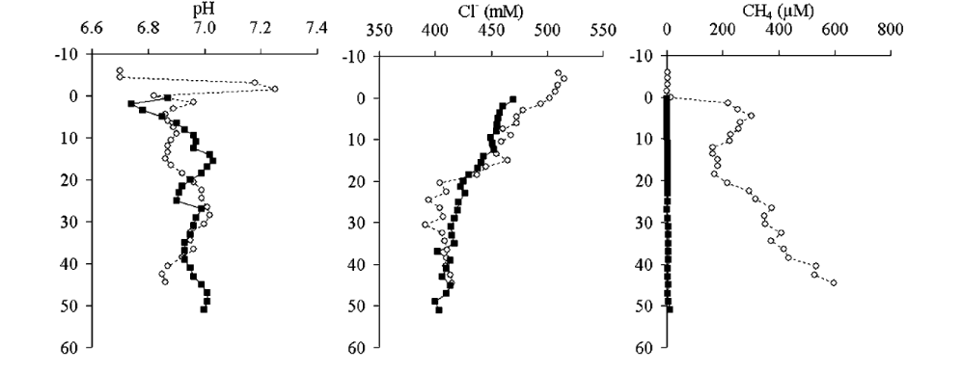
Georgia estuary SAP1 old

Slide 8
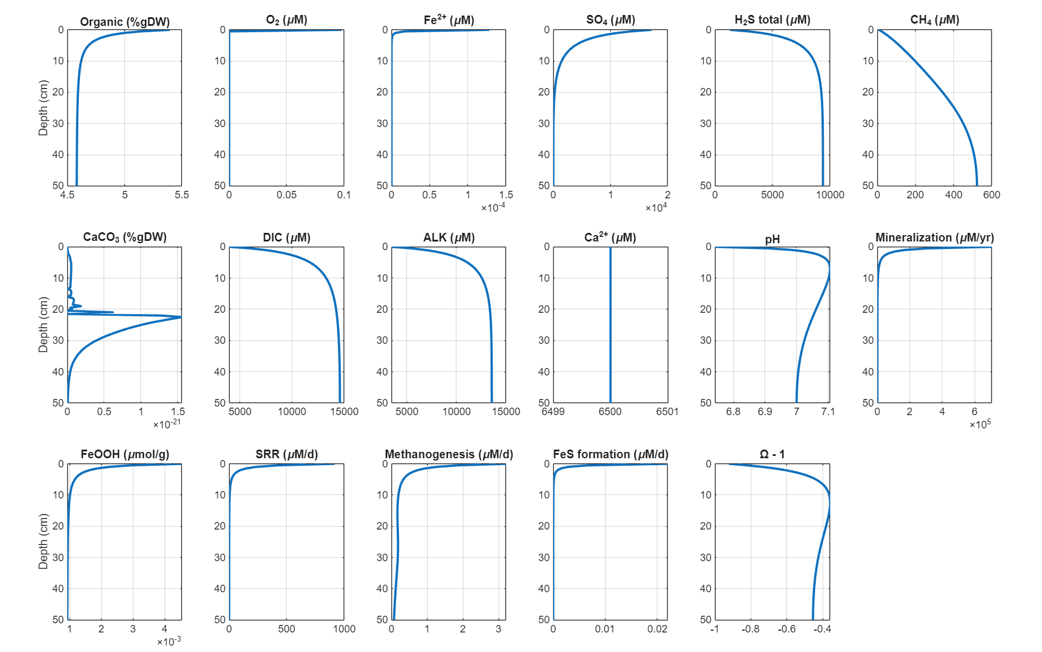

Slide 9
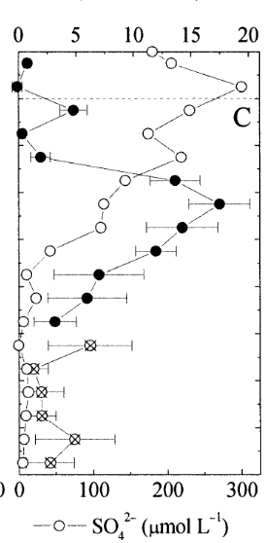
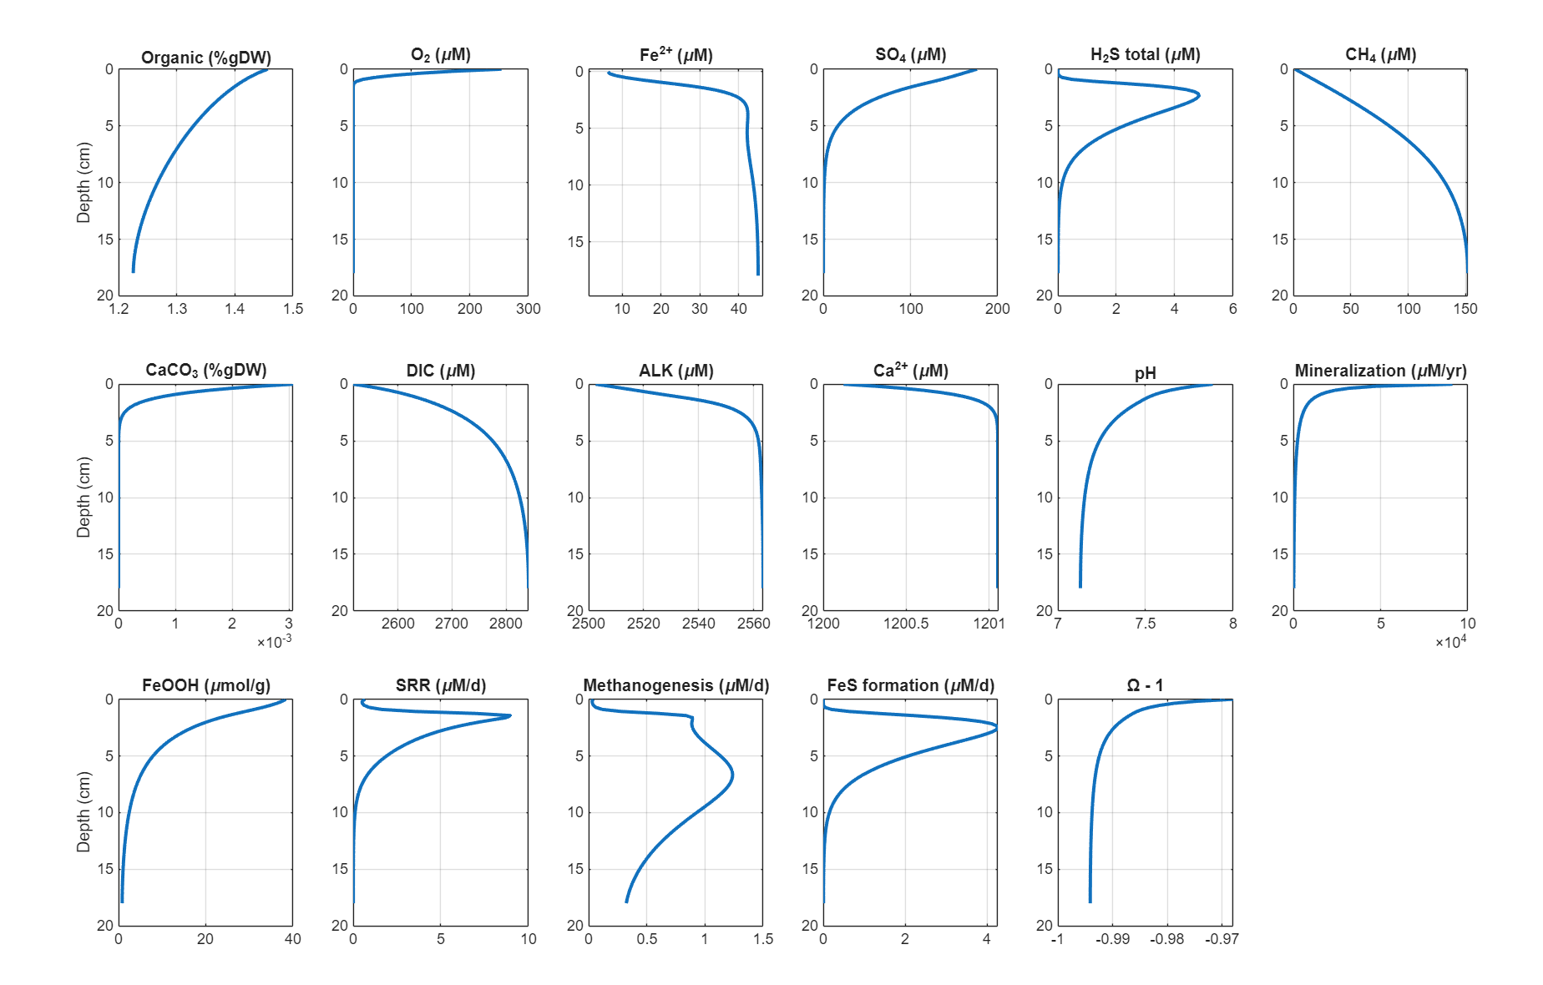
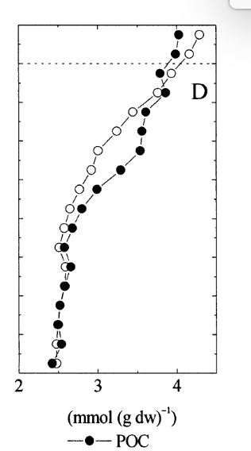
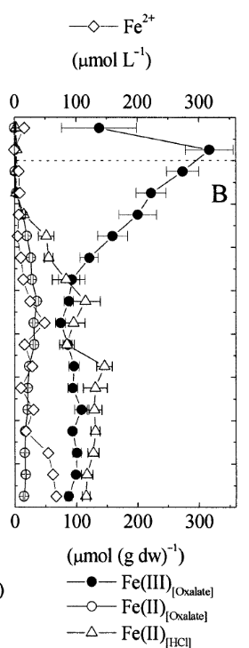
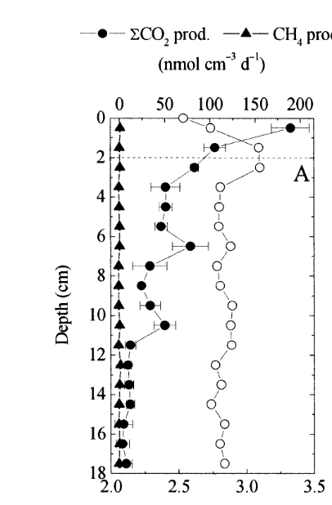
Lake Michigan

Slide 10
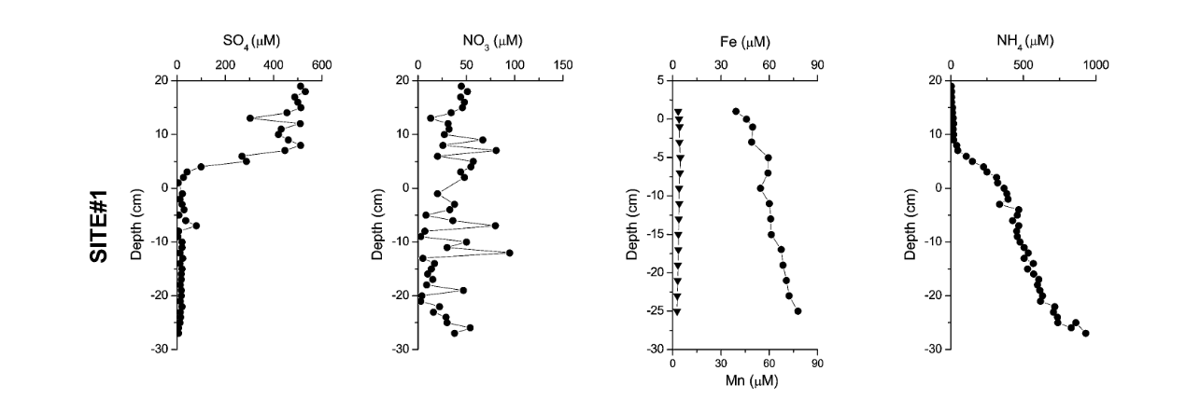
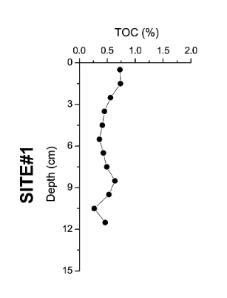
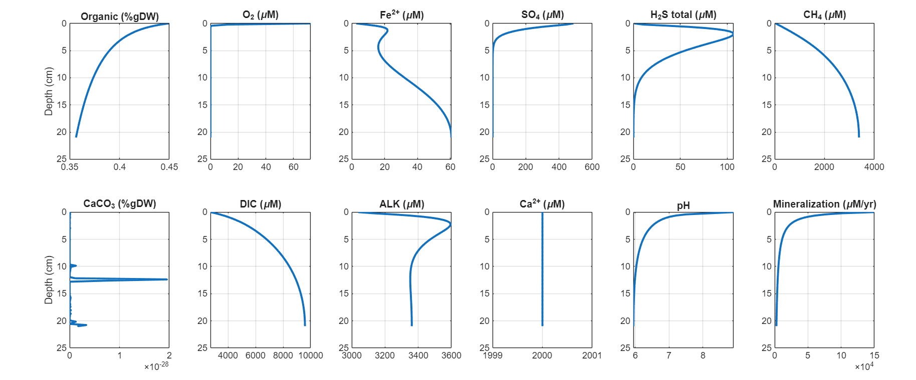
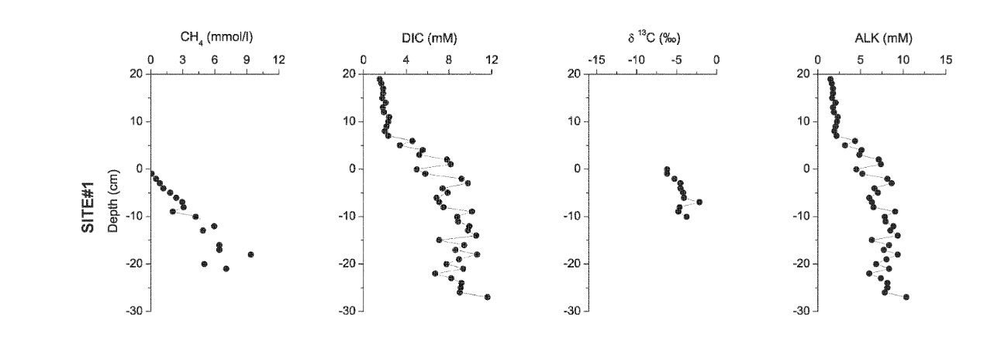
Geneva 1

Slide 11
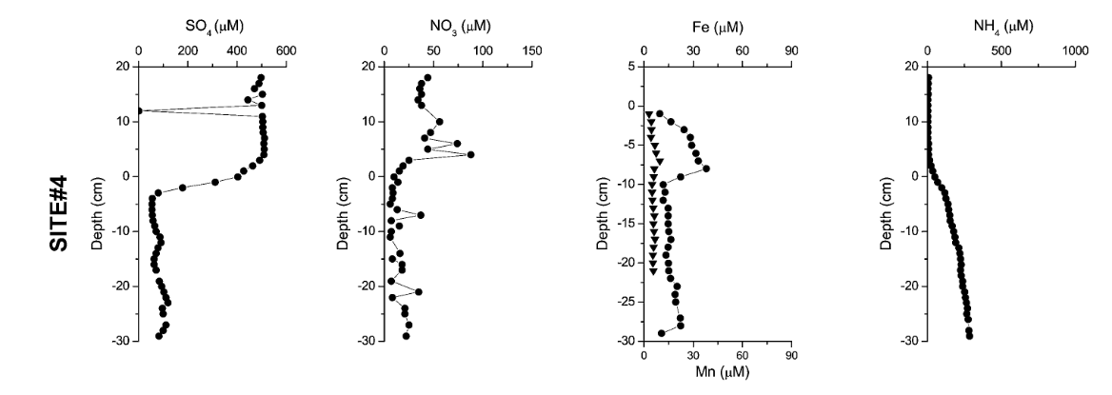
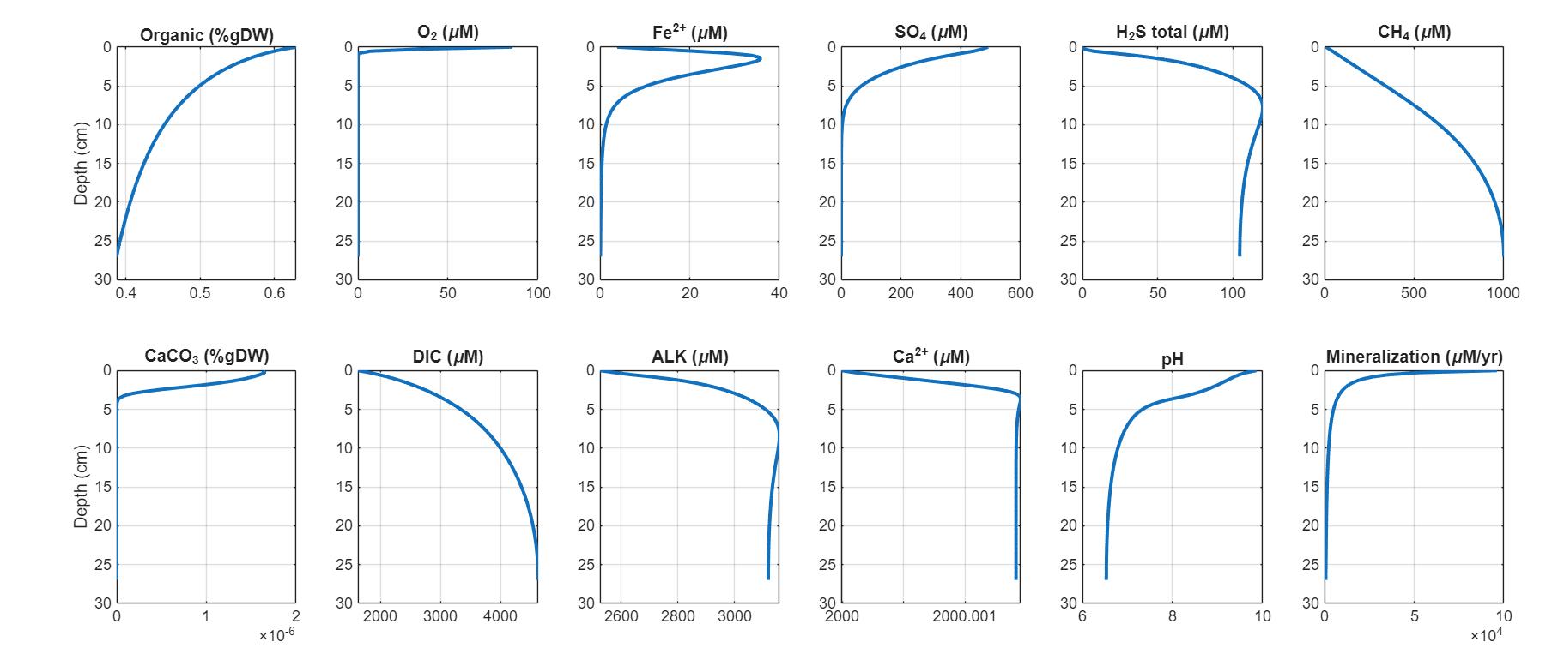
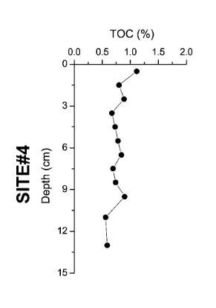
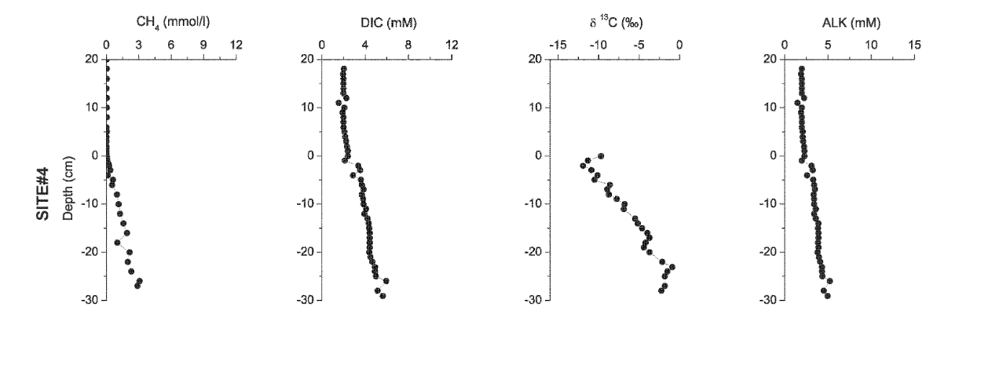
Geneva 4 old

Slide 12
